Slide 1
Workshop
Prerequisites
Git
.NET 8 SDK
Visual Studio Code with at least the following extensions installed:
C# Dev Kit
REST Client
Docker for desktop
You can also use PodMan as a Docker Desktop alternative. In that case, follow the PodMan specific instructions in the Dapr documentation (links below) and use the appropriate PodMan CLI commands during the workshop in stead of the Docker CLI commands.
Install the Dapr CLI and initialize Dapr locally
All scripts in the instructions are PowerShell scripts. If you're working on a Mac, it is recommended to install PowerShell for Mac.

Slide 2


Workshop
Edwin van Wijk
Sander Molenkamp

Slide 3
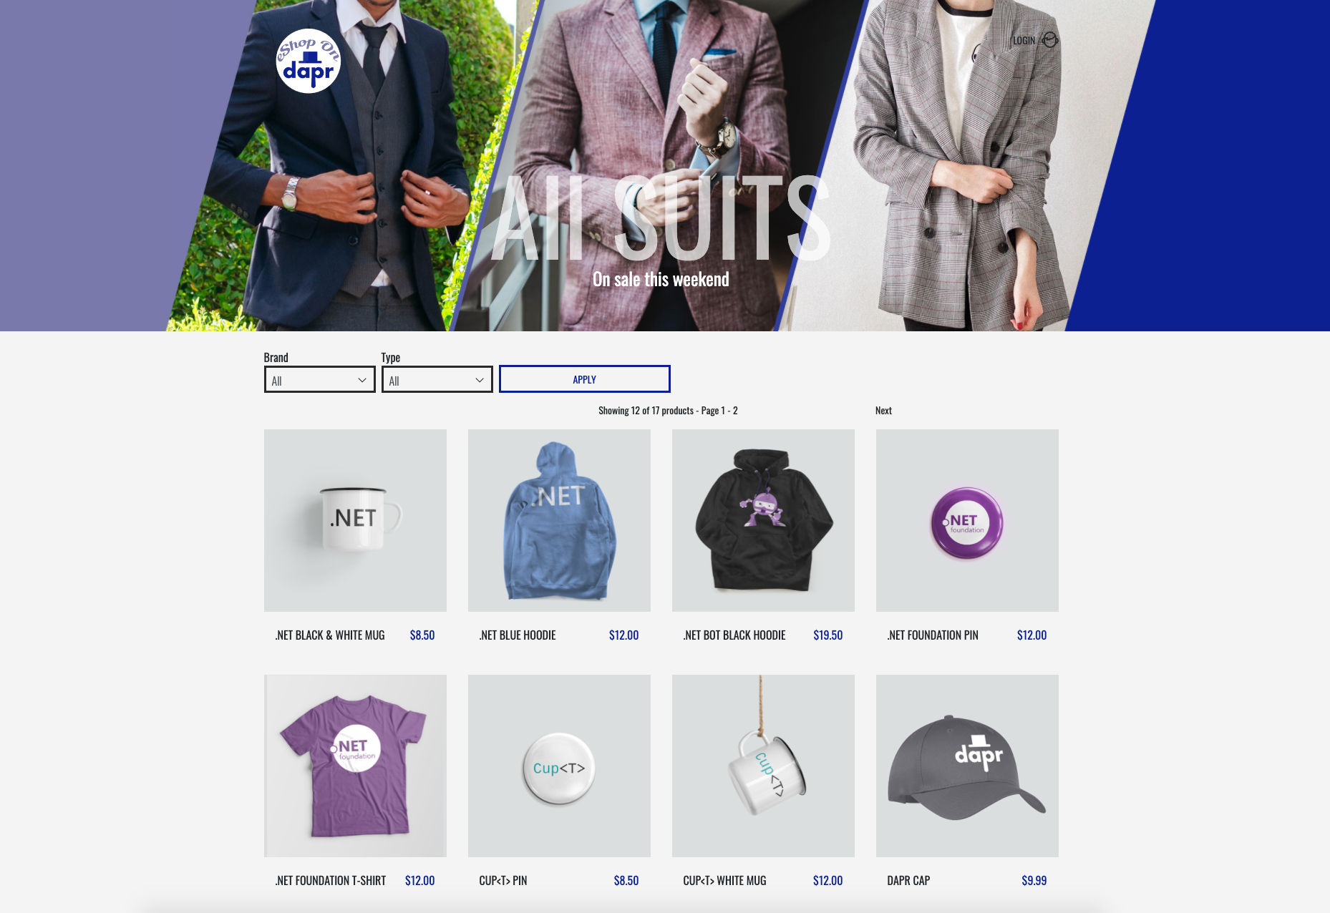
eShop
https://github.com/dotnet-architecture/eShopOnContainers
https://github.com/dotnet-architecture/eShopOnDapr

Slide 4
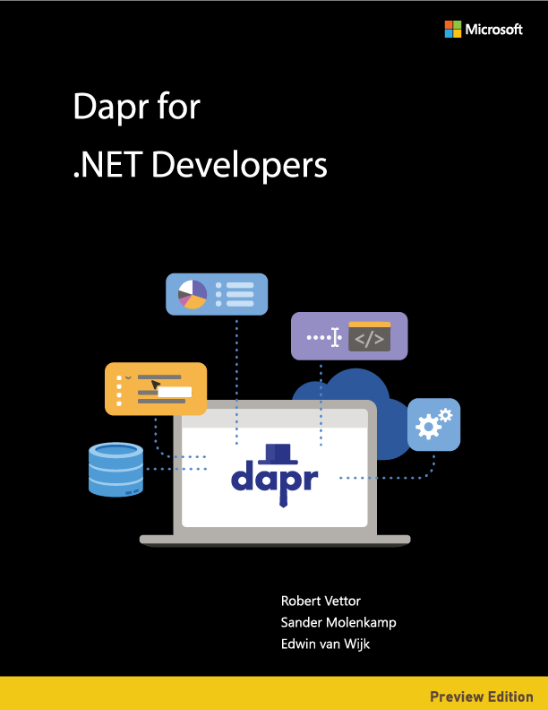
Online version:
https://docs.microsoft.com/dotnet/architecture/dapr-for-net-developers/
PDF version:
https://aka.ms/dapr-ebook

Slide 5
Agenda
Dapr 101
Sample app
Hands
on
+ whatever questions & discussions come up 😀

Slide 6
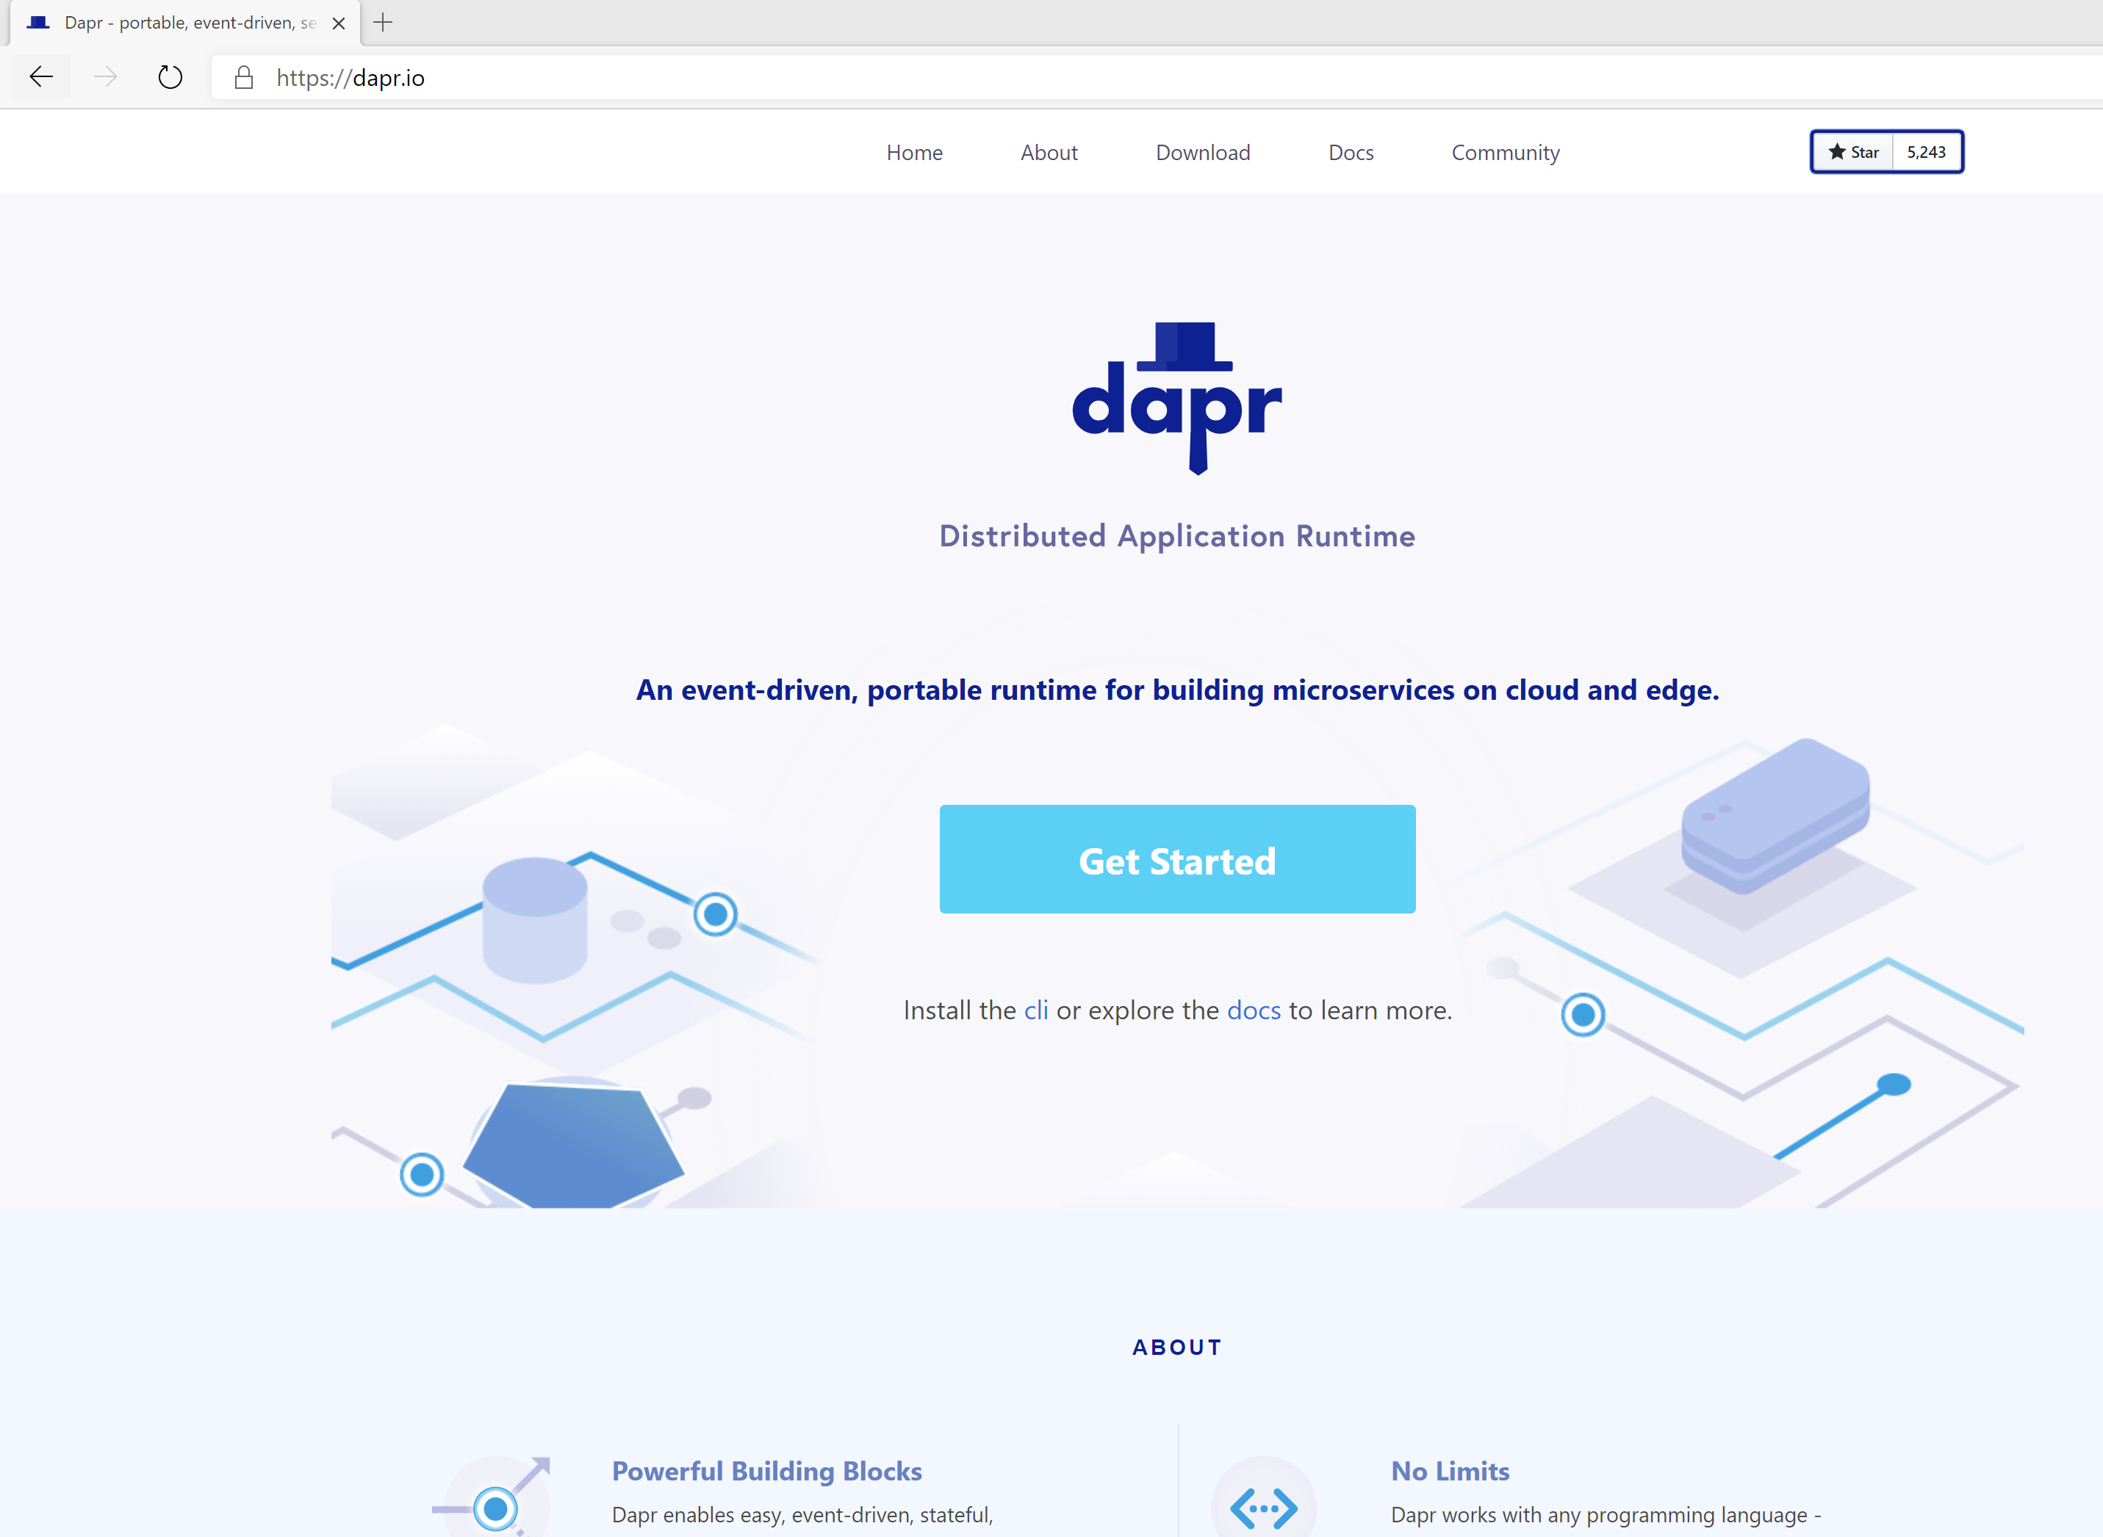

Distributed Application Runtime
Portable, event-driven, runtime for building distributed applications across cloud and edge
https://dapr.io
Developers can focus on building apps and not on infrastructure.

Slide 7

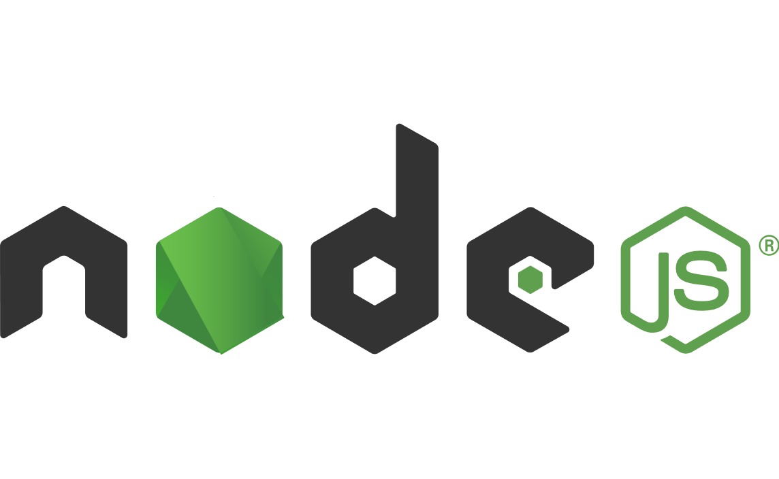


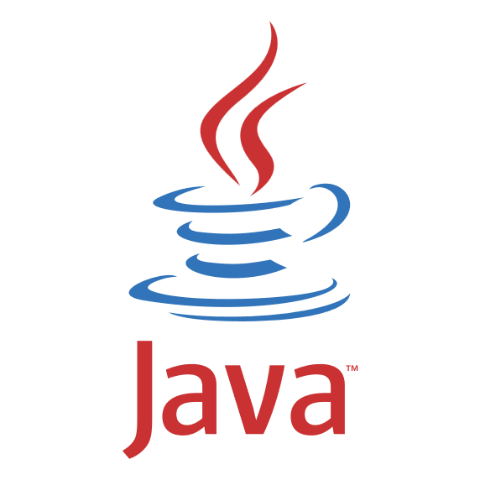
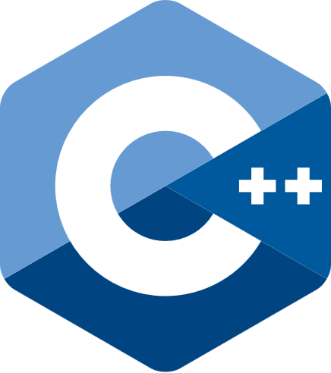


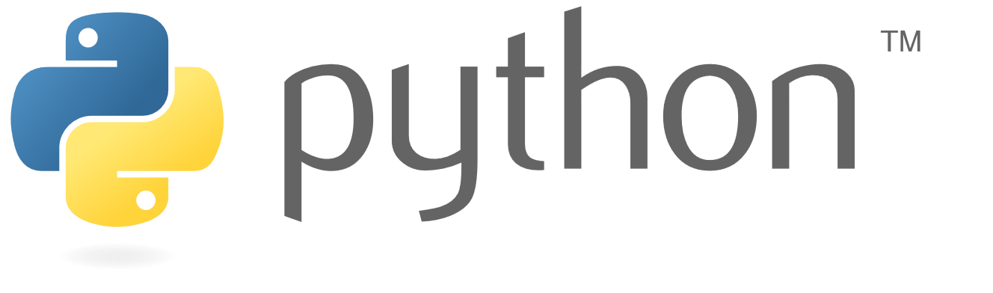
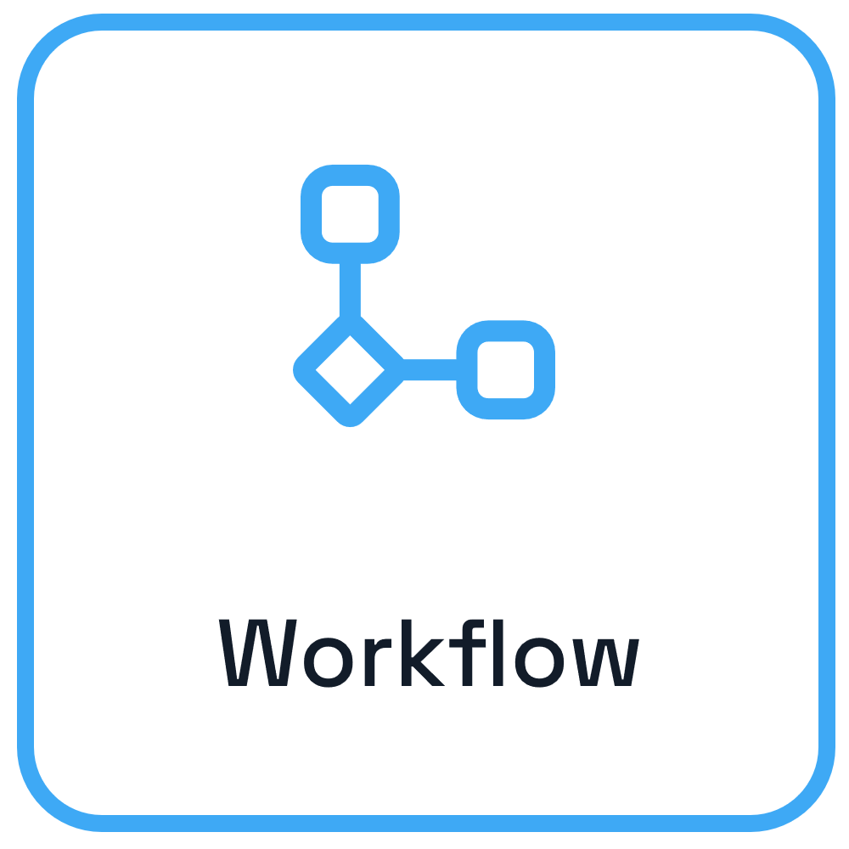

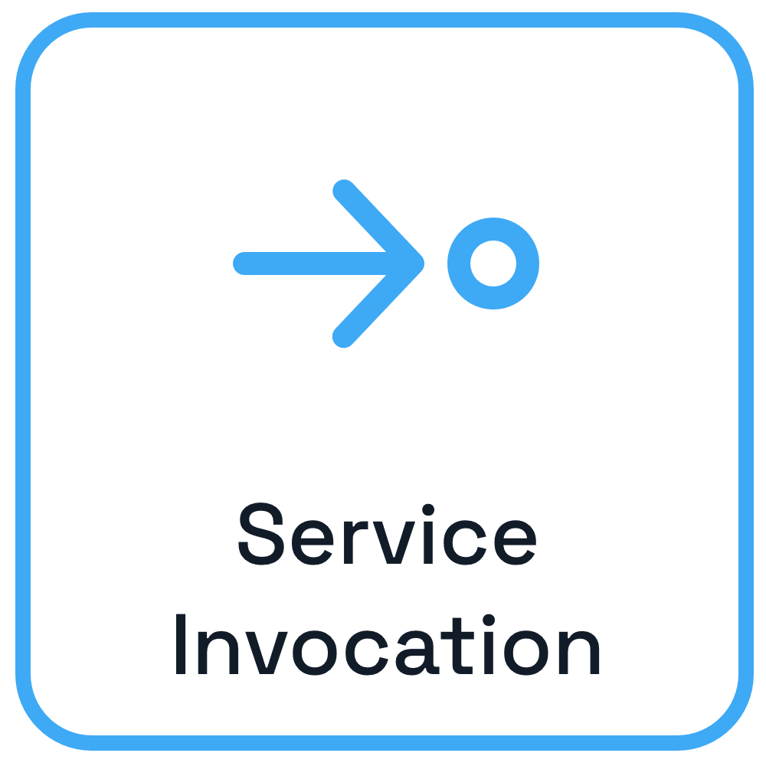
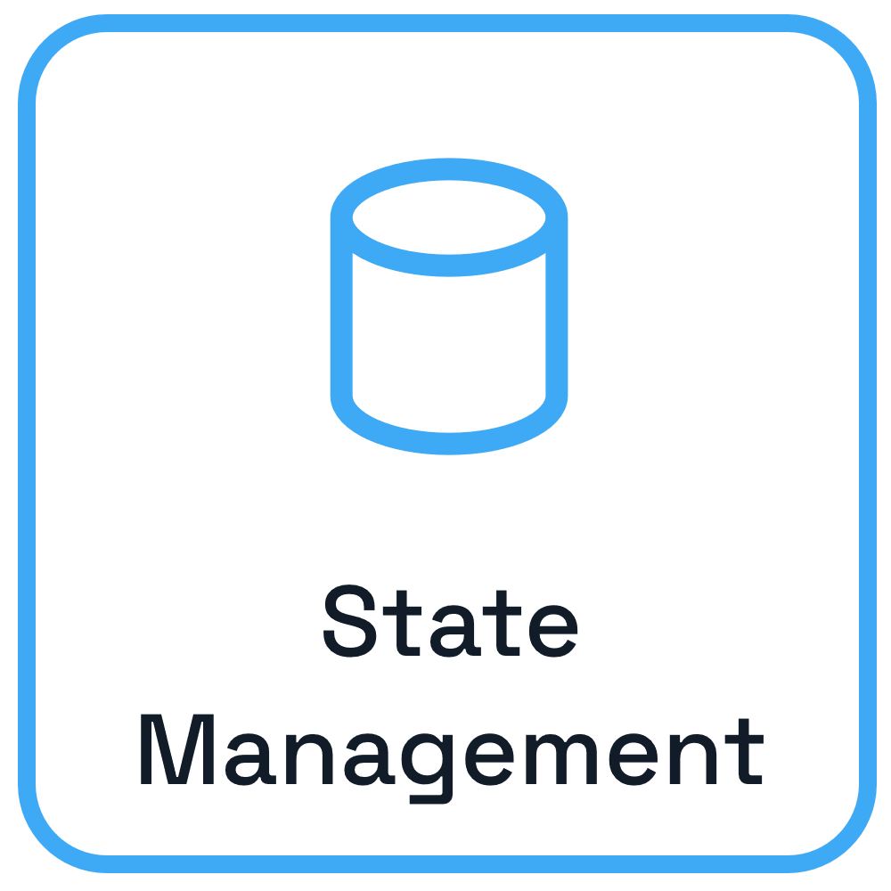
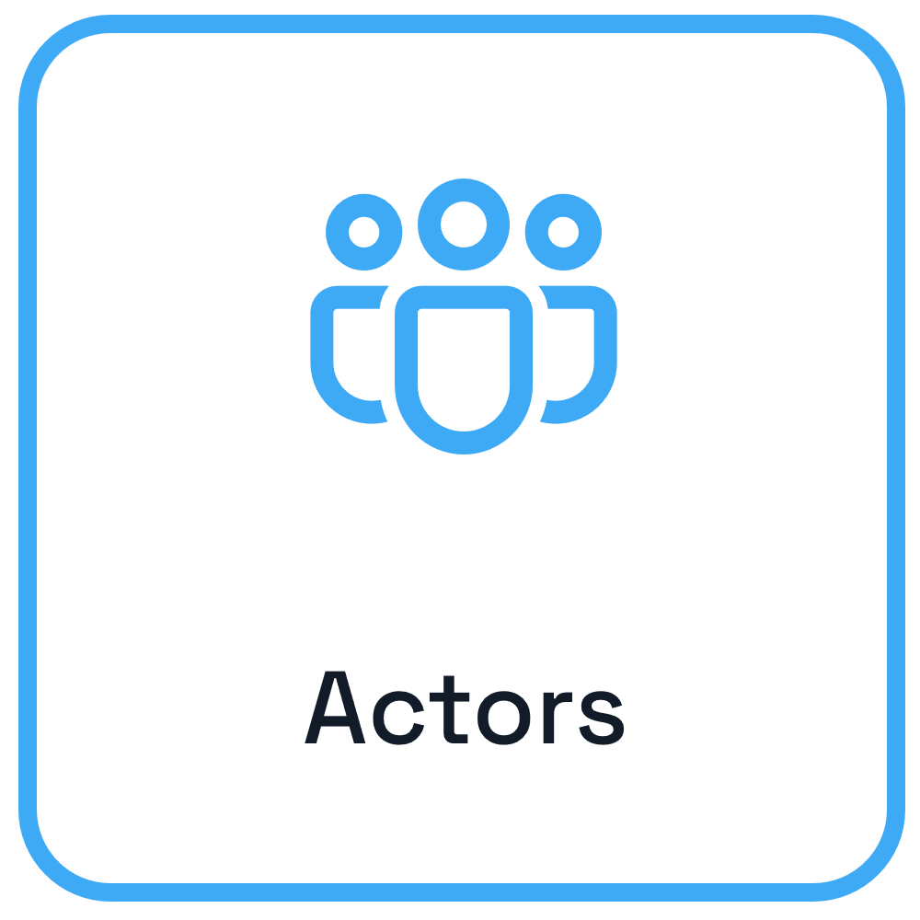



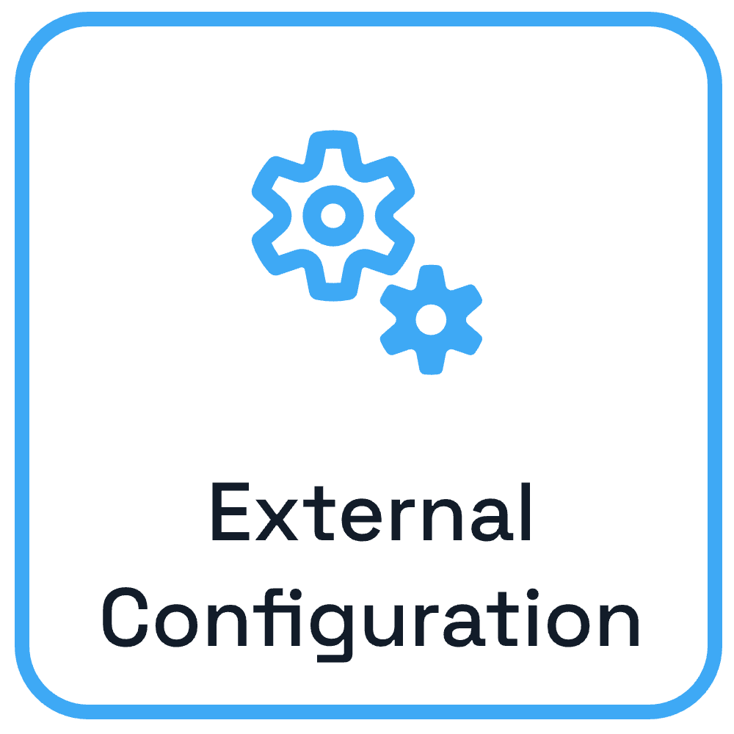

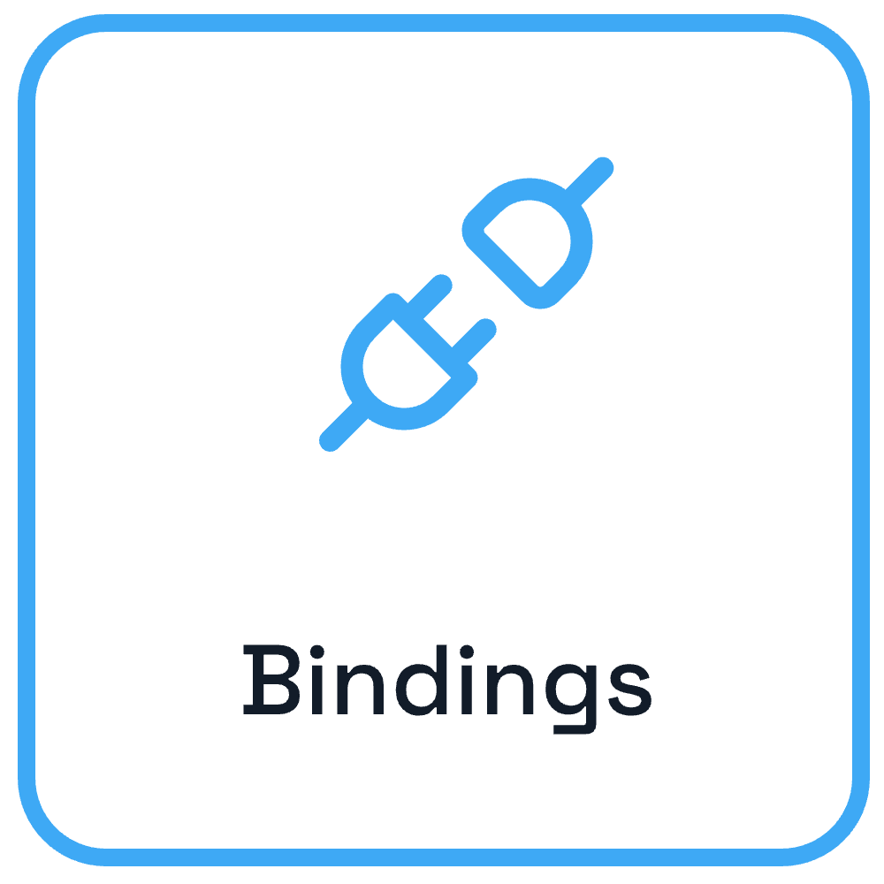
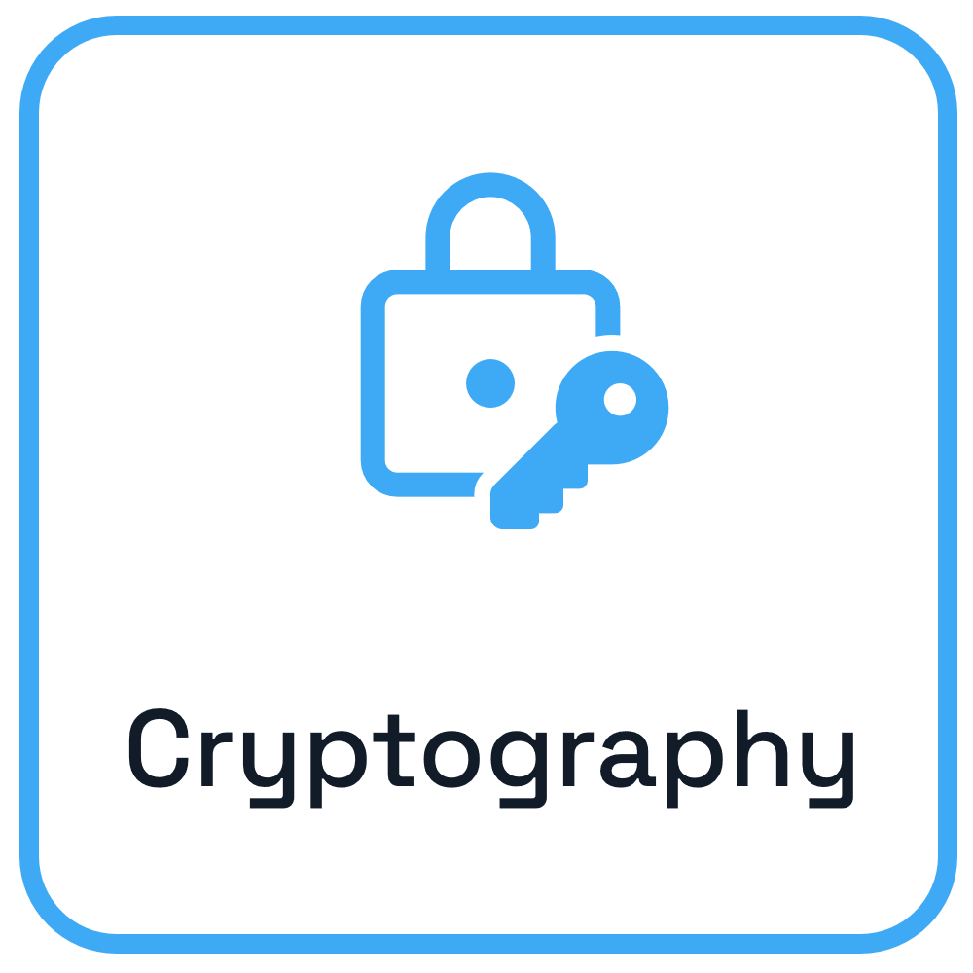
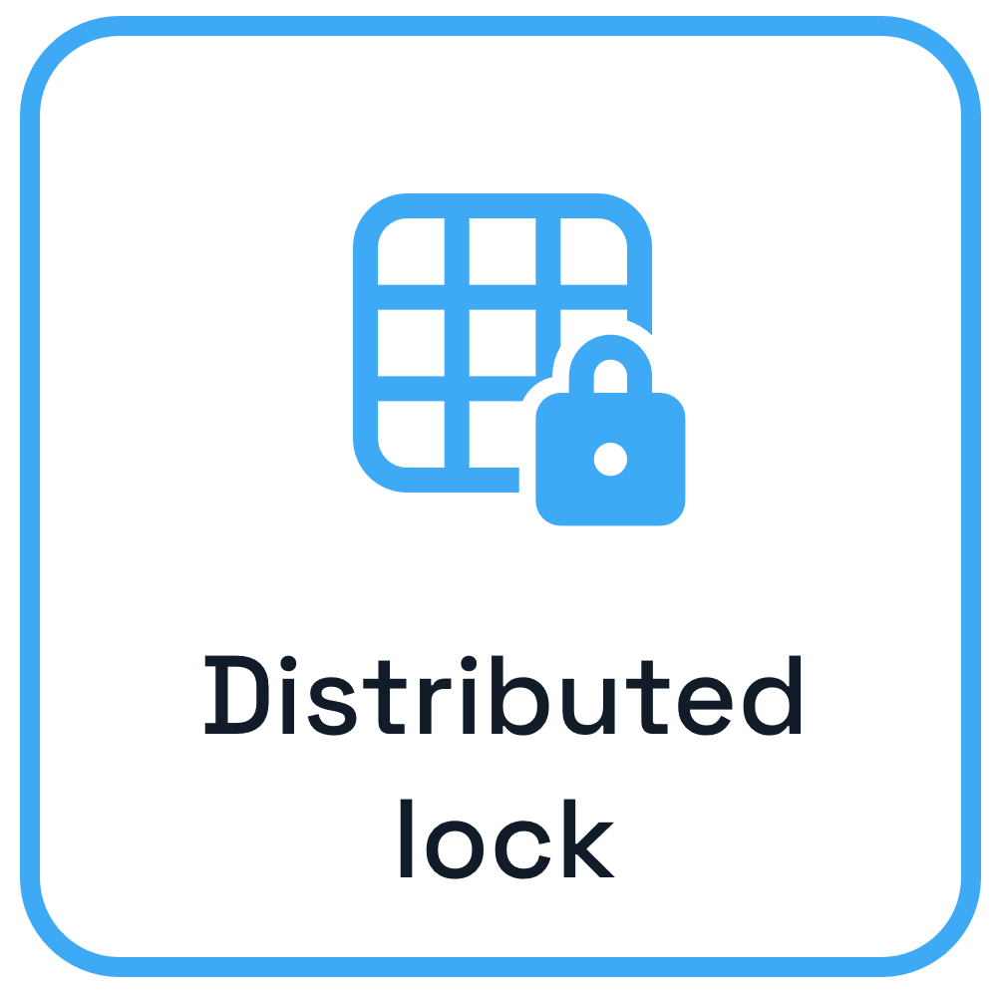
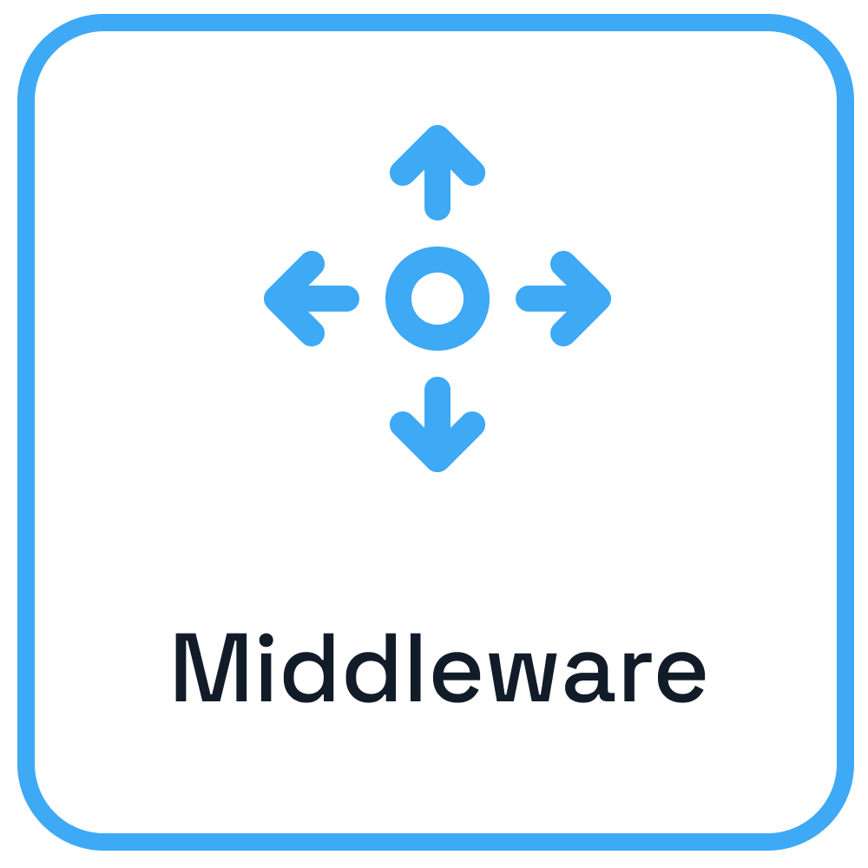
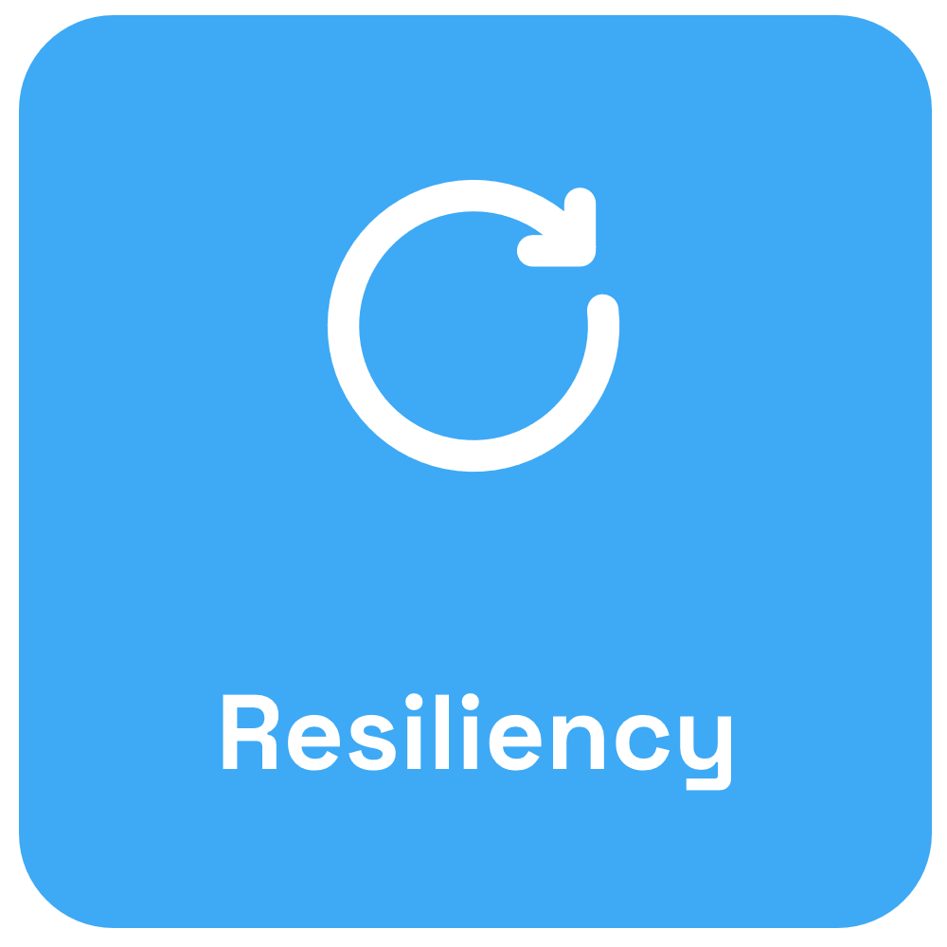




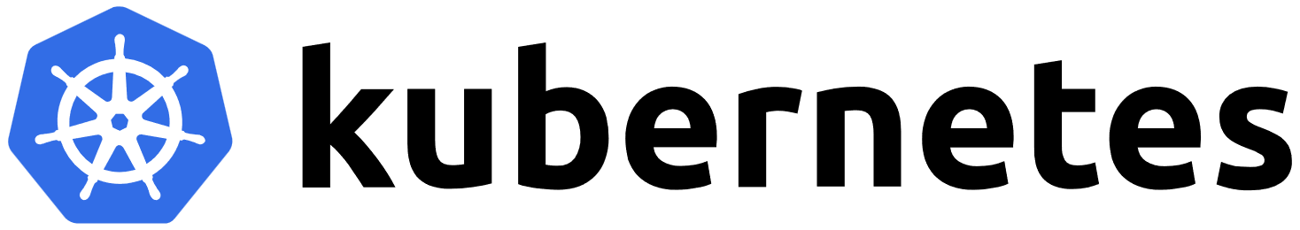

Microservice building blocks
Use any language or runtime
App
HTTP/gRPC
Host on any cloud or edge infrastructure

Slide 8

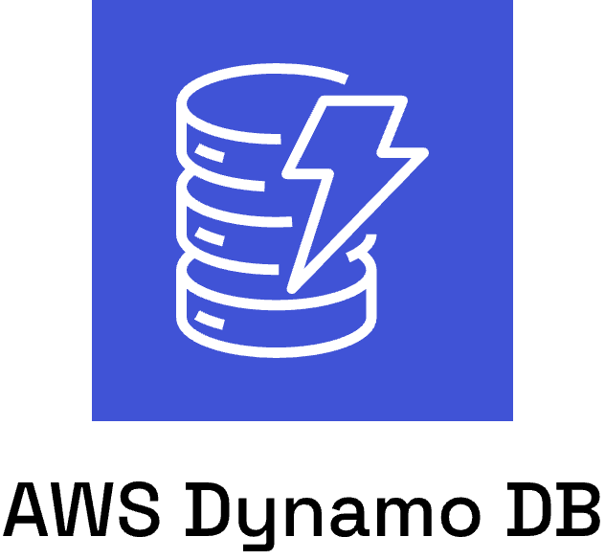
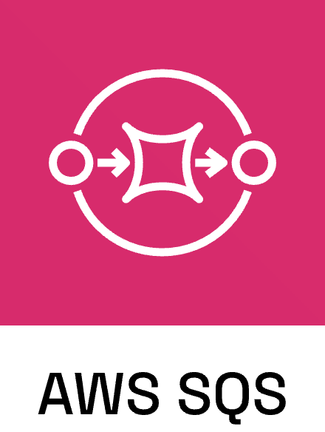
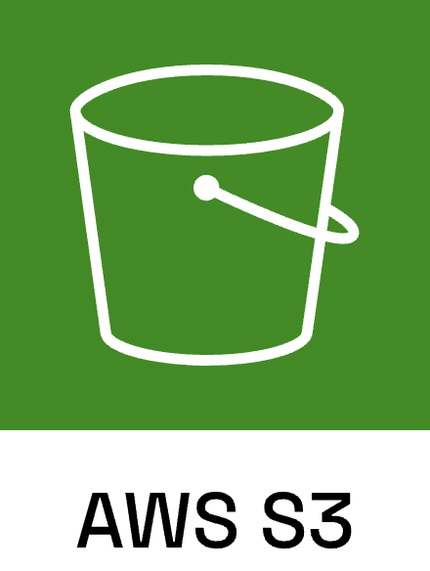

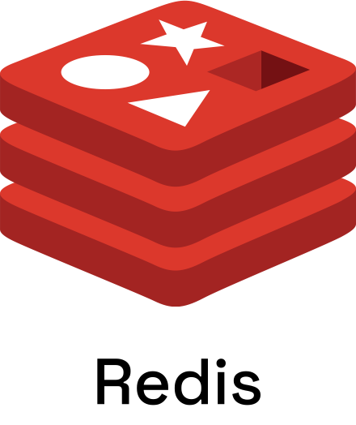

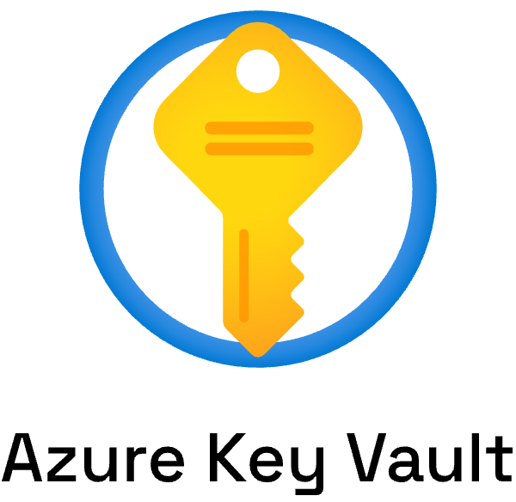
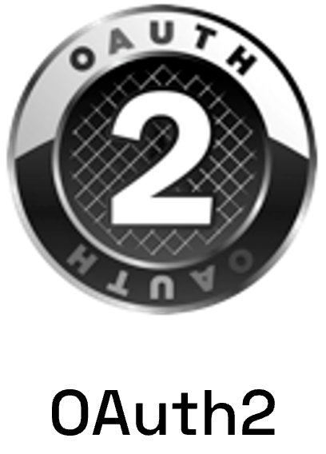

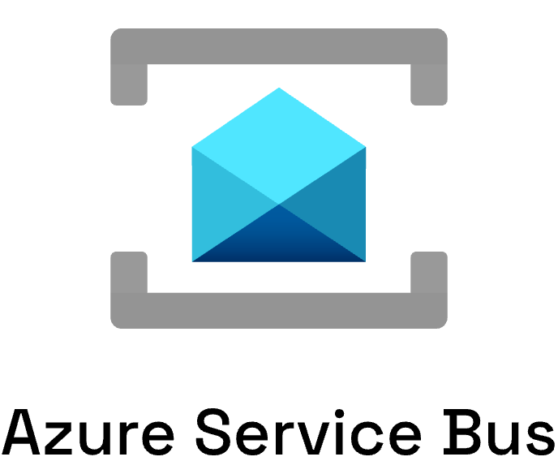
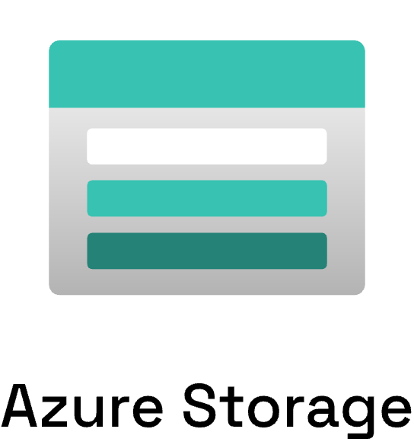
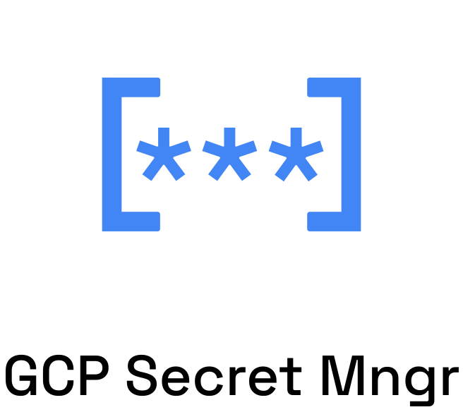
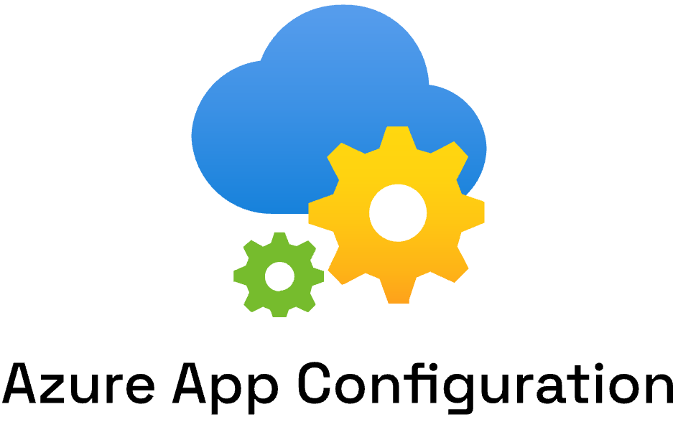
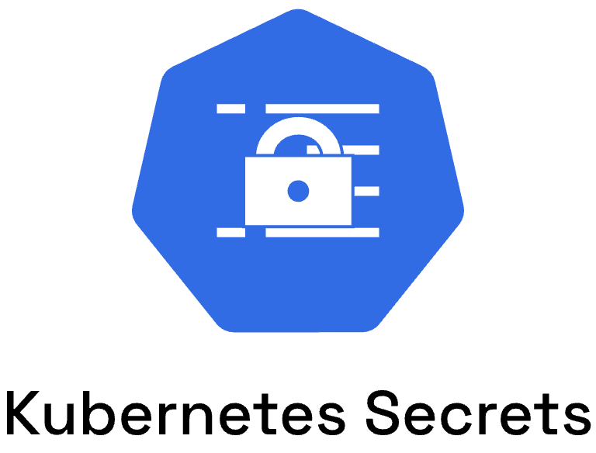
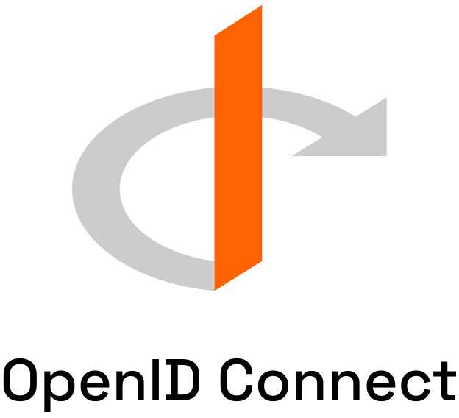

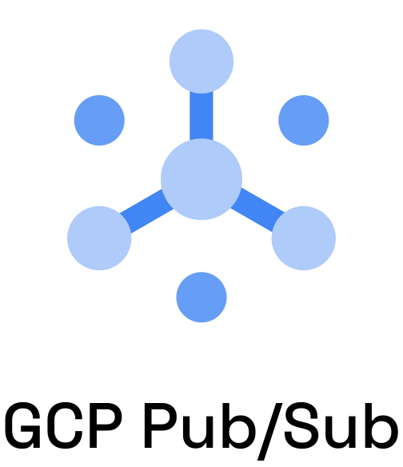
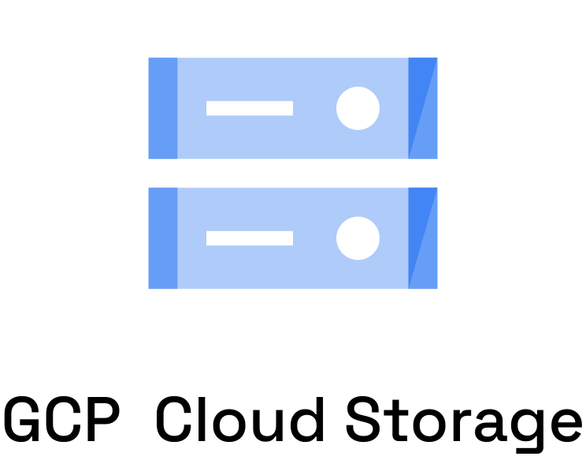

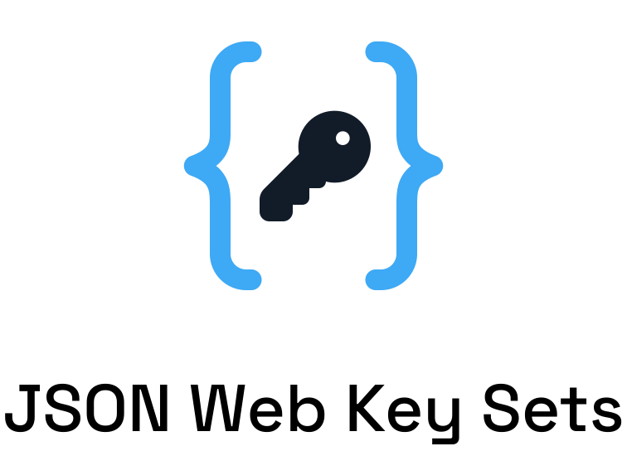



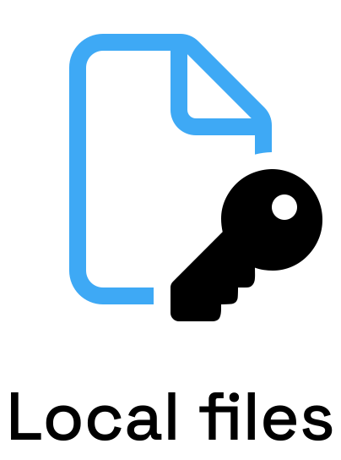
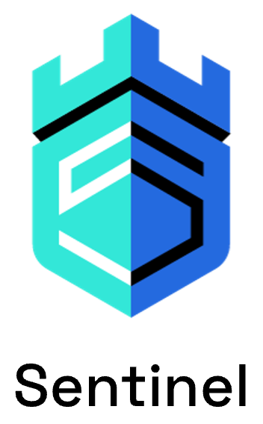
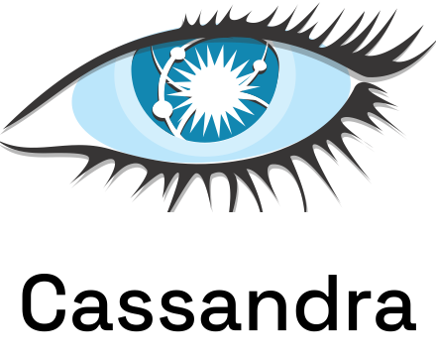




Dapr Components
App

Slide 9
Sidecar architecture
Dapr API
My App
App
HTTP/gRPC
Application code
Dapr sidecar
POST http://localhost:3500/v1.0/invoke/cart/method/order GET http://localhost:3500/v1.0/state/inventory/item50 POST http://localhost:3500/v1.0/publish/mybroker/order-messages GET http://localhost:3500/v1.0/secrets/vault/dbaccess POST http://localhost:3500/v1.0-beta1/workflows/dapr/businessprocess/start
Notes:
It’s important to note that Dapr uses a sidecar architecture. So this means that your application code does not have to include any Dapr code or library.
Instead, the Dapr runtime runs alongside your application, either as a separate process or as a container. And you communicate with the runtime through the API.
For production scenario’s, it’s recommended to use Kubernetes as a host. In that case your application container and the Dapr sidecar container would run together in a single pod.

Slide 10
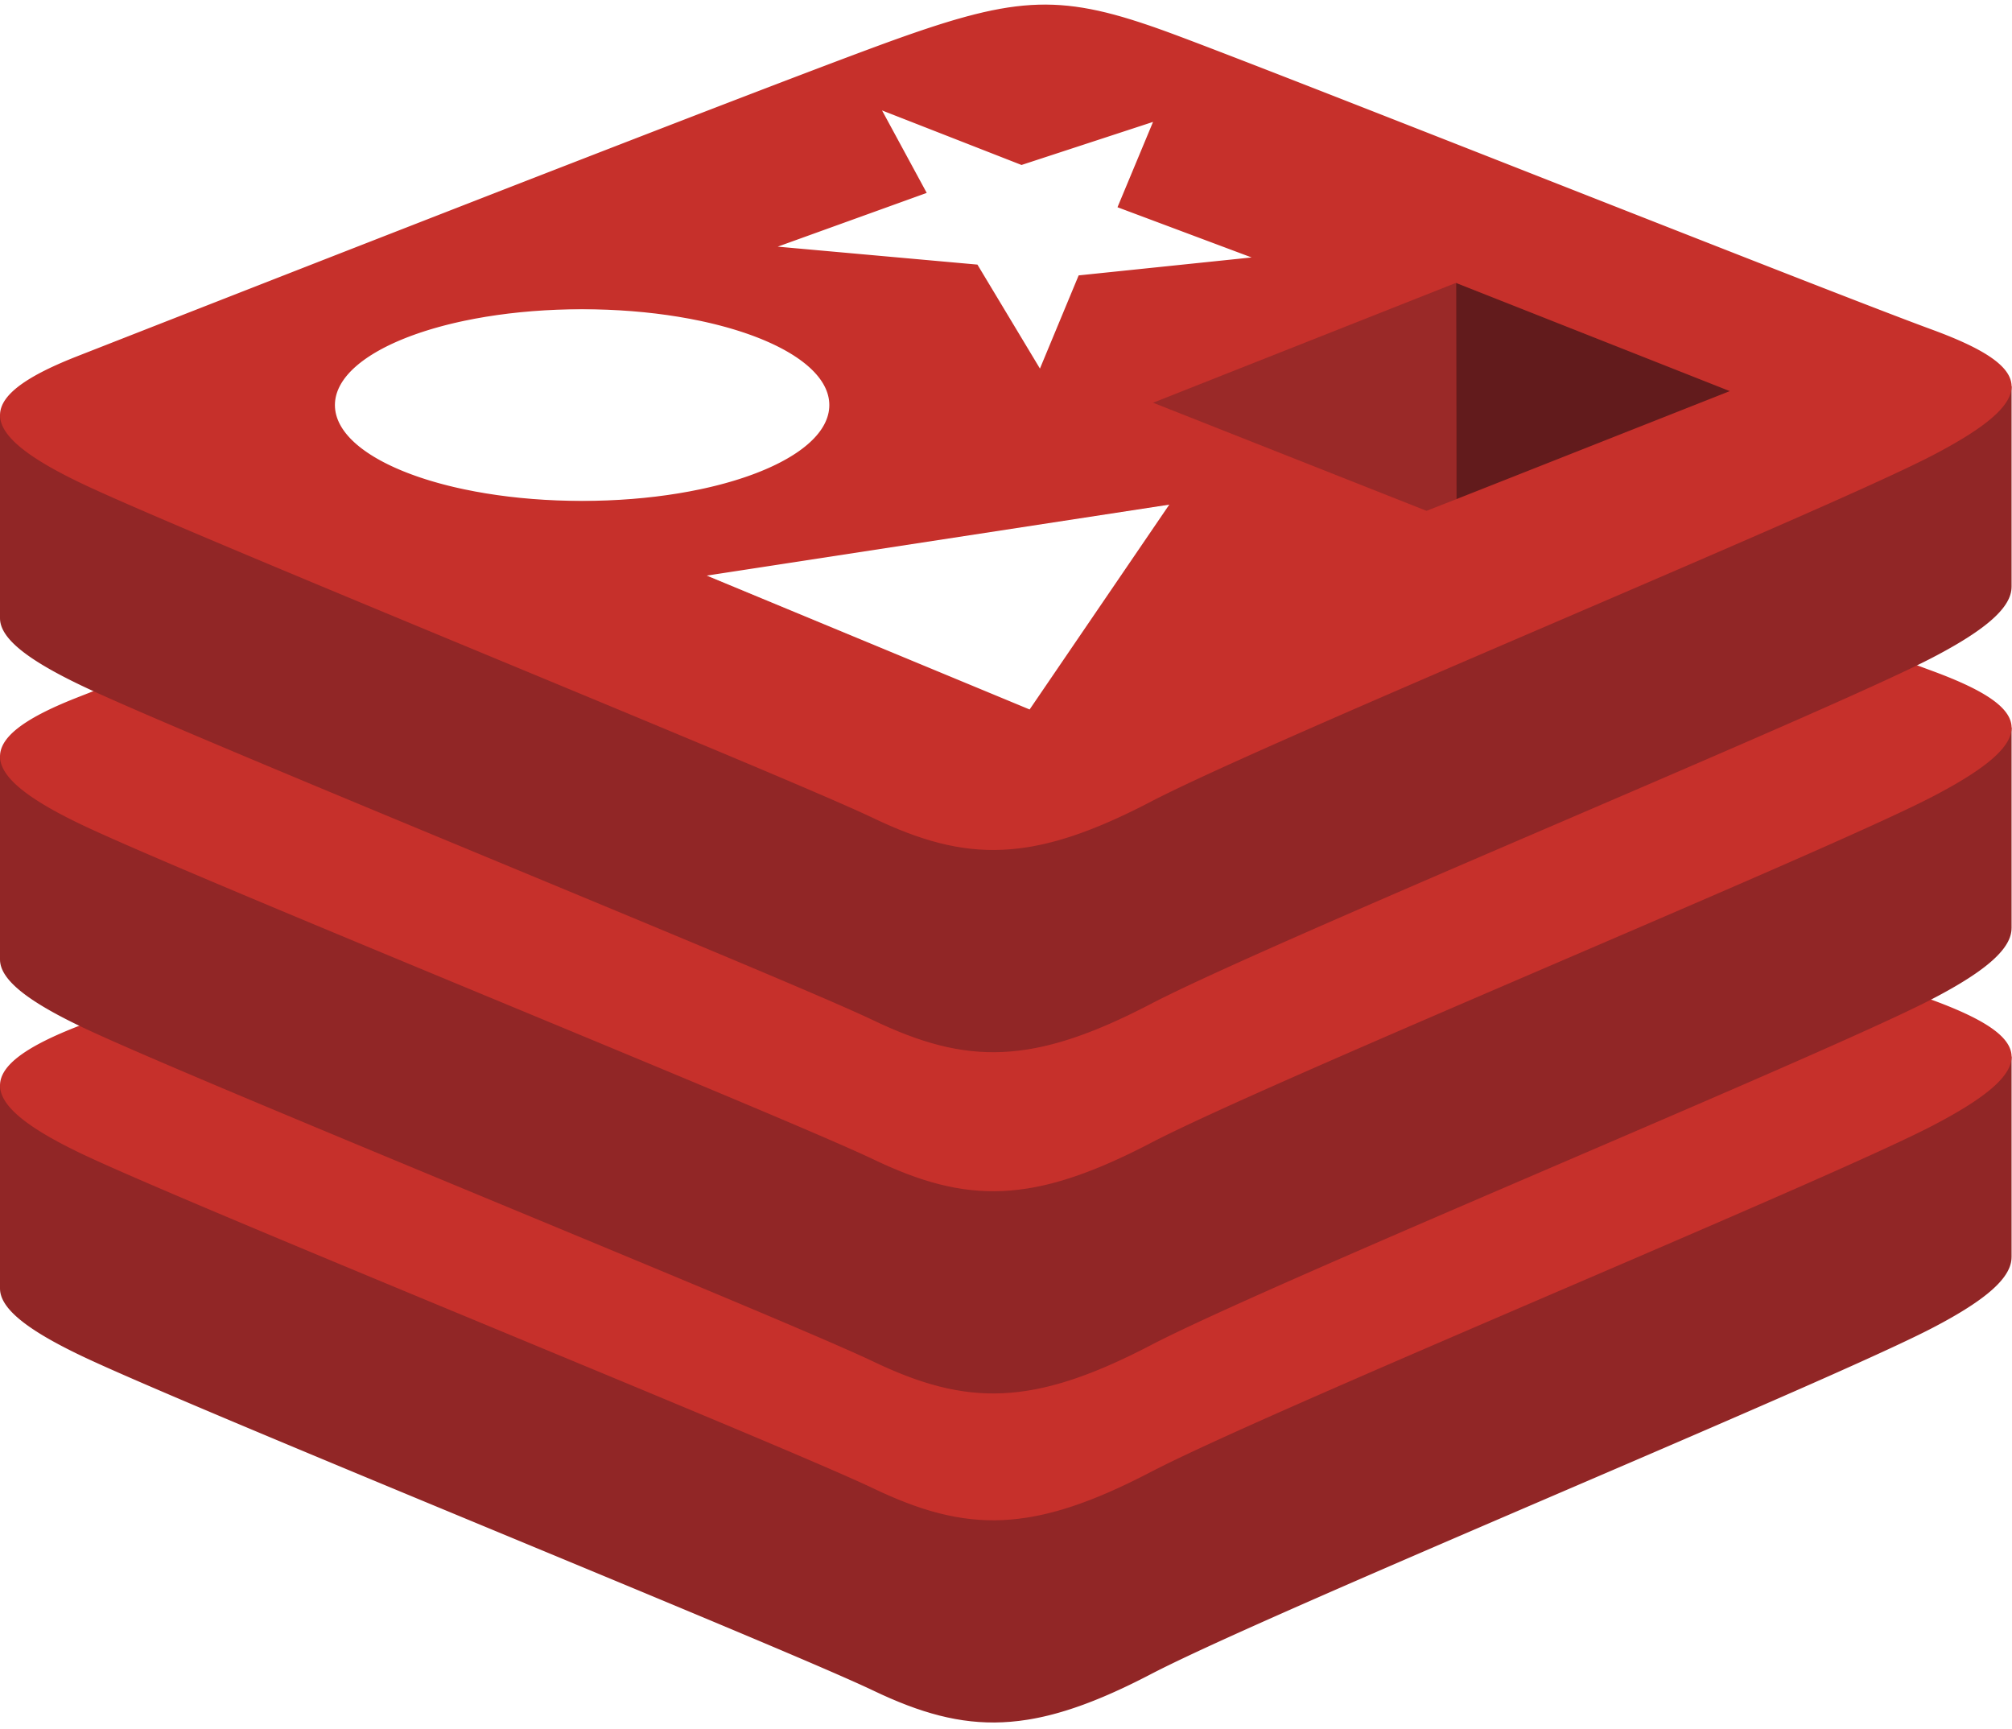
Example: State Management
Component Configuration
state.redis
Service A
App

Slide 11

Example: State Management
Component Configuration
state.redis
state.azure
.cosmosdb
Service A
App

Slide 12
Example: State Management
Component Configuration
state.redis
state.azure
.cosmosdb
Service A
App

Slide 13
Example: Service Invocation
Service A
Service B
App
App
Service discovery
Encryption (mTLS)
Distributed tracing
Access control lists
Retry policies

Slide 14
71 Dapr Components
27 I/O Bindings
13 General
7 Azure
5 AWS
18 State stores
11 Pub/Sub
APNs
Cron (Scheduler)
HTTP
InfluxDB
Kafka
Kubernetes Events
MQTT
PostgreSql
RabbitMQ
Redis
Twilio
Twitter
SendGrid
Azure Blob Storage
Azure EventHubs
Azure CosmosDB
Azure Service Bus Queues
Azure SignalR
Azure Storage Queues
Azure Event Grid
AWS DynamoDB
AWS S3
AWS SNS
AWS SQS
AWS Kinesis
Aerospike
Cassandra
Cloudstate
Couchbase
etcd
Hashicorp Consul
Hazelcast
Memcached
MongoDB
PostgreSQL
RethinkDB
Redis
Zookeeper
Azure CosmosDB
Azure SQL Server
Azure Table Storage
Azure Blob Storage
Google Cloud Firestore
Redis Streams
Apache Kafka
AWS SNS/SQS
Azure Events Hub
Azure Service Bus
GCP Pub/Sub
Hazelcast
MQTT
NATS streaming
Pulsar
RabbitMQ
1 AliCloud
Blob Storage
2 GCP
GCP Cloud Pub/Sub
GCP Storage Bucket
8 Secret stores
Azure Key Vault secret store
Azure Key Vault with Kubernetes MI
AWS Secrets Manager
GCP Secret Manager
HashiCorp Vault
Kubernetes Secrets
Local environment variables (for Development)
Local file (for Development)
4 HTTP Middleware
2 Name Resolution
OAuth2
Open Policy Agent (OPA)
Rate limit
Bearer
Kubernetes
Multicast DNS

Slide 15
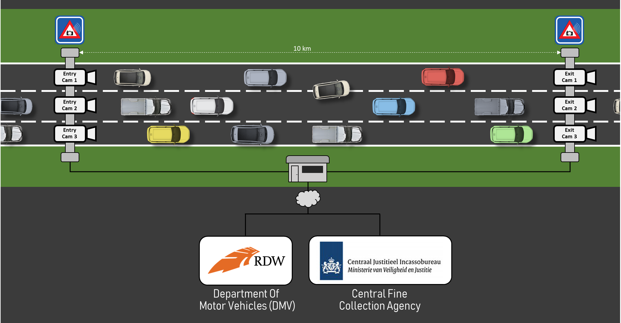
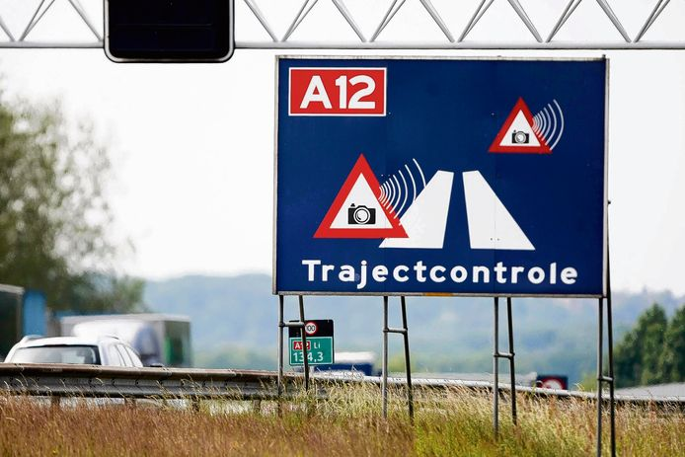
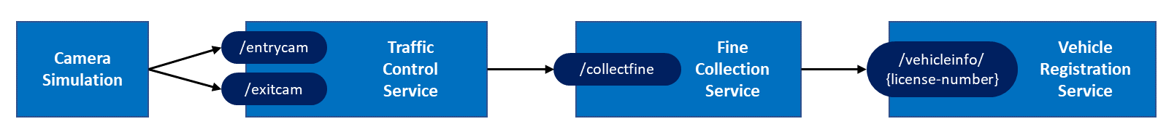
Dapr Traffic-control sample

Slide 16






Camera
Simulation
MQTT
Sidecar
Traffic
Control
Service
5
5
5
/entrycam
5
/exitcam
2
3
Redis
3
RabbitMQ
2
Sidecar
Fine
Collection
Service
2
2
/collectfine
1
4
6
SMTP
4
1
Sidecar
Vehicle
Registration
Service
Secrets
1
/vehicleinfo/ {license-number}
6
1
Service invocation
3
State management
5
Input binding
2
Publish / subscribe
4
Output binding
6
Secrets management

Slide 17
How Dapr is run
Kubernetes
Standalone (self-hosted)
apiVersion: apps/v1
kind: Deployment
metadata:
name: my-go-app
labels:
app: my-go-app
spec:
selector:
matchLabels:
app: my-go-app
template:
metadata:
labels:
app: my-go-app
annotations:
dapr.io/enabled: "true"
dapr.io/app-id: "my-go-app"
dapr.io/app-protocol: ”http"
dapr.io/app-port: ”5000”
…
dapr run --app-id my-go-app \
--app-protocol grpc \
--app-port 5000 \
--components-path ./config \
go run main.go
dapr run --app-id my-net-app \
--app-protocol http \
--app-port 5001 \
--components-path ./config \
dotnet run
dapr run --app-id my-app \
--app-protocol http \
--app-port 5002 \
--components-path ./config \
./my-exe
Notes:
So, how do you get that magical sidecar that does all these things?
Well, on k8s, that’s as simple as decorating your deployment with a few annotations (2 required, enabled, app-id, but there is more)
Dapr will inject a sidecar into your Pod, and your app has the same API you had on your laptop during the development
In a standalone mode (or self-hosted as it is sometimes called) you use the “dapr run” command with a few flags
Whether this is Java, C#, Go, Python or compiled executable

Slide 18

D
E
M
O
Traffic control

Slide 19
Hands-on
You are going to add Dapr to an existing app
Building blocks included in the workshop:
service invocation
pub/sub
state management
bindings
secrets management
Start with Traffic-control sample communicating over HTTP

Slide 20

Hands-on
2 ways of doing the workshop:
DIY : reach goals by studying the Dapr documentation and figuring out yourself how to use the Dapr building blocks
Step-by-step : follow the step-by-step instructions
Execute all assignments in order and don't skip any assignments!
https://github.com/edwinvw/dapr-workshop

Slide 21
Other building blocks …
Actors
Workflow
External configuration
Cryptography
Distributed Lock
Scheduled Jobs (not yet in diagram…)

Slide 22

Thank you!
Resources:
All things Dapr:
https://dapr.io
https://docs.dapr.io
Free e-book: Dapr for .NET Developers
https://aka.ms/dapr-ebook
Dapr Traffic-control sample app:
https://github.com/edwinvw/dapr-traffic-control

